Slide 1

Gokaraju Rangaraju Institute of Engineering & Technology
Bachupally, Kukatpally, Hyderabad- 500090
DEPARTMENT OF INFORMATION TECHNOLOGY
MINI PROJECT ABSTRACT PRESENTATION
On
SMART HOUSEHOLD AUTOMATION
BATCH NO:12
Name Roll Numbers
1. D Karthik 18241A1275
2. N Sai Sujith 18241A1298
3. J Ganesh 18241A1282
4. G Lokesh Reddy 18241A1281
5. V Sharath 18241A12B7
Under the guidance of
Project Guide
Dr. Ravikiran K
Associate Professor
Head of the Department
Dr. K. Prasanna Lakshmi
Notes:
Post pandemic, everyone are so aware of their surroundings and are trying their best to avoid contact with the things that are used by the people commonly. So, in those common items few of the items are switches in our house

Slide 2



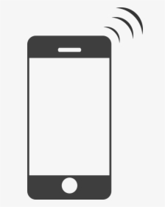
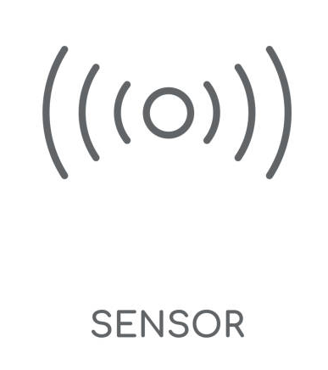
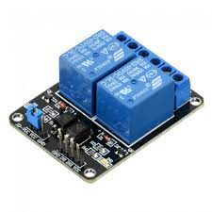



Project Roadmap

Slide 3

MODULES
HARDWARE MODULE
USER MODULE

Slide 4
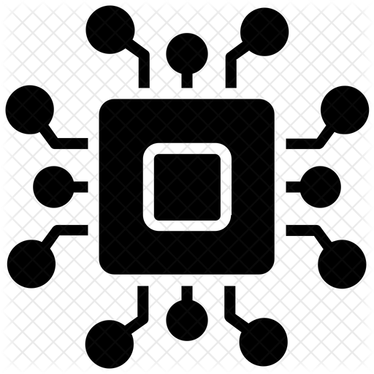
HARDWARE MODULE
NodeMCU
Relay module
dh11 Sensor

Slide 5
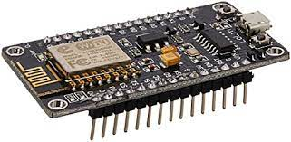
NodeMCU
→ Allows the user to connect to the device and control the attached appliance remotely from any location
→ Connects the device from any remote location using the user wifi name and password and allows the user to connect to the device allowing to to access the appliance using the relays in the device

Slide 6
Relay module
→ Relay module is an electrical switch which is operated by an electromagnet
→ The work of the relay module is to accept task from NodeMCU given by the user and perform its task to either turn ON or OFF the device

Slide 7
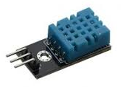
Dh11 Sensor
→ Sensor will be given static data regarding the ranges of temperature and humidity
→ Sensor checks the ranges of temp and humidity and initiates to either connect with Relay module or not
→ Basing on the default temperature and humidity range set by the user, the data of temperature and humidity will be shown as gauge in the Blynk App

Slide 8
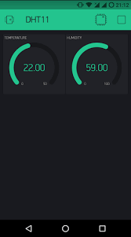
Temperature
Gauge
Humidity
Gauge

Slide 9

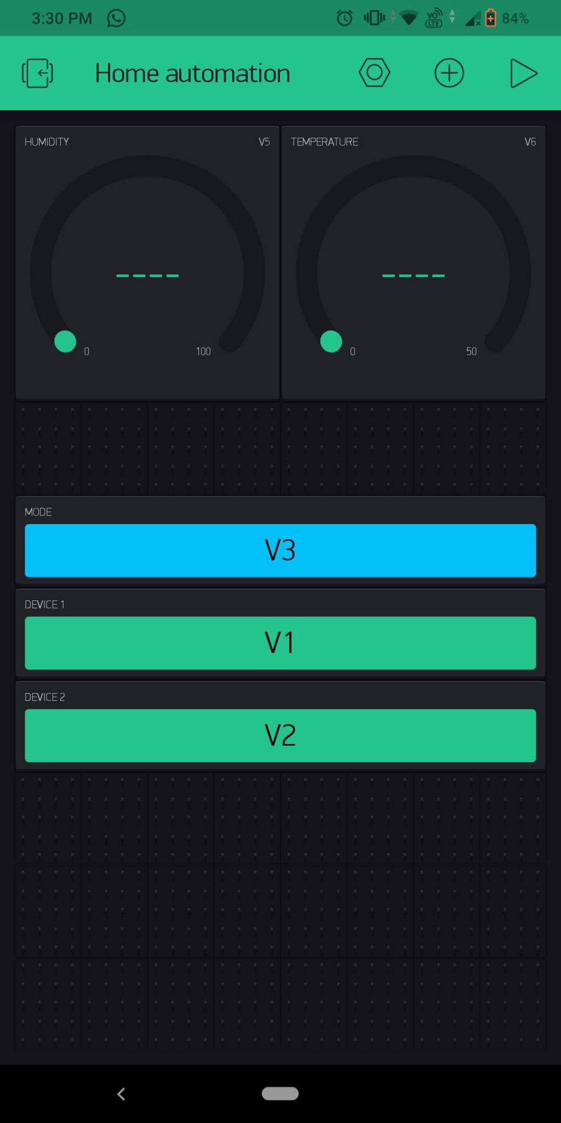
USER MODULE
→ The gauges show the live temperature and humidity that are changing in the location where the device is present
→ The buttons allow the user to control the appliances which are connected to the relay parts of the device

